Slide 1
Facial Expression Recognition from Face Profile Images
BY
Anushka Kumari (UIN: 669671211)
Miriyala Sree Harish Kumar (UIN: 663258586)

Slide 2
Contents:
Abstract
Project Goal
Methodologies
Data Exploration and Preprocessing
Algorithms used
KNN
Opencv with Neural Networks
Logistic Regression
YOLO V4
Final Results
Conclusion

Slide 3
Abstract:
This project focuses on predicting human emotions from facial expressions using machine learning techniques. Recognizing emotions through facial features is a complex task due to the variety of expressions. We used multiple methods to predict emotions, including K-Nearest Neighbors (KNN), Logistic Regression, OpenCV-based Neural Networks, and YOLO V4. Each model analyzes the data differently, allowing us to compare their performance in predicting emotions.
While these models help recognize emotions, they vary in how accurate and efficient they are. By testing and refining these techniques, we aim to improve the system's accuracy. This approach makes the system more reliable and useful for real-world applications in areas like healthcare, education, and security, where understanding emotions can enhance interactions and decision-making.

Slide 4
Project Goal:
This project aims to identify the basic Human emotions such as sad, fear, happy, anger, surprised, and neutral emotions. The dataset we have used is ICML_Face_Dataset.
We plan to use methods like K-Nearest Neighbors (KNN), OpenCV Neural Networks, Logistic Regression, and YOLOv4, as each model analyzes the data differently, allowing us to compare their performance in predicting emotions.
After training, we will test the model on images to see how well it predicts emotions, using evaluation metrics like accuracy, precision, recall, F1-score, Root Mean Squared Error(RMSE) and Mean Absolute Error(MAE) to evaluate its performance.
Once successful, the model could be applied to real-world scenarios like analyzing customer emotions, assessing mental health, or enhancing virtual assistants to respond to emotions more effectively.

Slide 5
Methodologies: Data Exploration and Preprocessing:
Data Cleaning:
Understand the dataset, Handle missing data, Detect and remove duplicates, Inspect and clean pixel data, Normalize pixel intensity, Handle outliers, Validate labels, Address data imbalance, Save the cleaned dataset.
Data Preprocessing:
Data loading and conversion, Resizing images, Normalize pixel values, Label encoding, Data augmentation, Data flattening, Train-test split, Handle class imbalance, Save preprocessed data

Slide 6
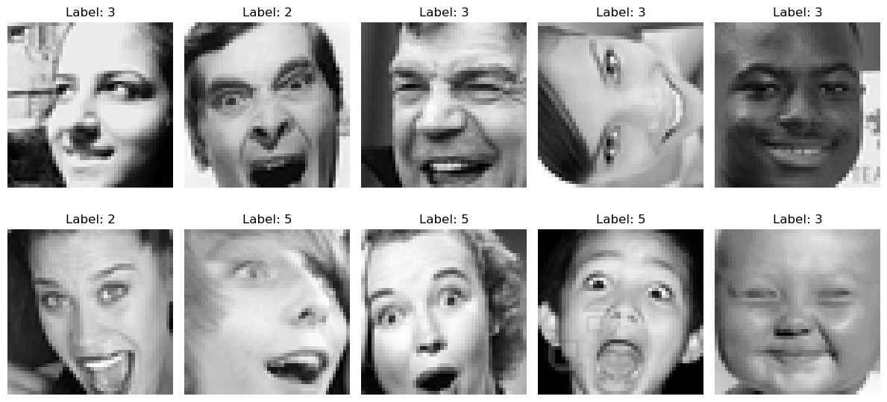
Algorithms used:
K-Nearest Neighbors – helps by comparing the features of an unknown face to stored examples of labeled expressions. It classifies the expression by finding the most common label among the closest matching examples.

Slide 7
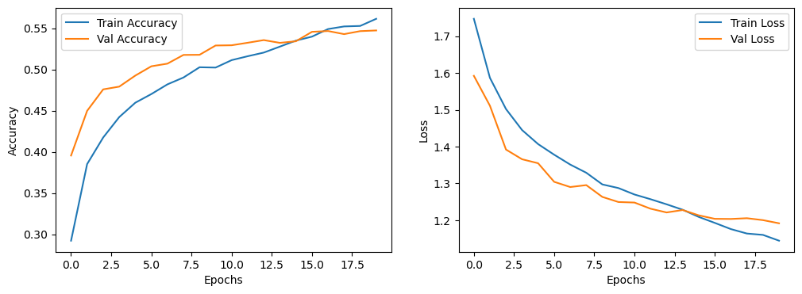
Algorithms used: (contd)
Opencv with Neural Networks - helps by detecting and extracting facial features and then using a trained neural network to analyze these features and classify them into different expressions. This approach makes recognition more accurate and efficient.

Slide 8
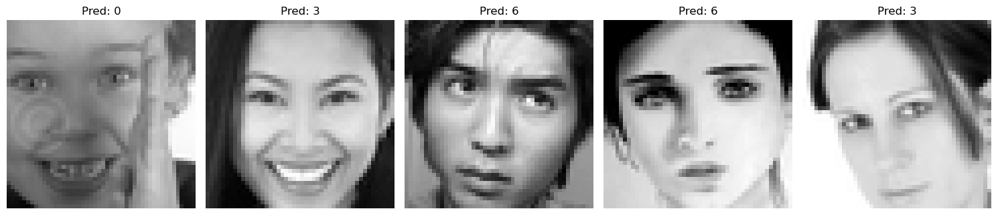
Algorithms used: (contd)
Logistic Regression - contributes by analyzing facial features and predicting the probability of an expression belonging to a specific category. It works well for simple tasks by creating decision boundaries between different expressions.

Slide 9
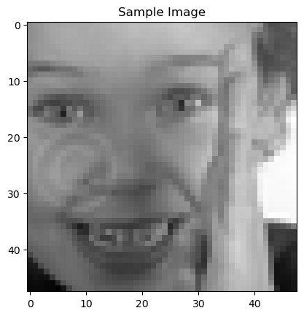
Algorithms used: (contd)
YOLO V4 - contributes by quickly detecting and localizing faces in images or videos. Once the face is detected, its features can be analyzed further to classify the facial expression.

Slide 10
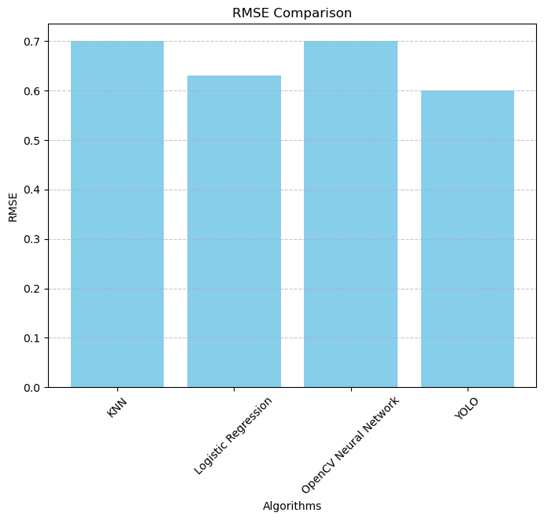
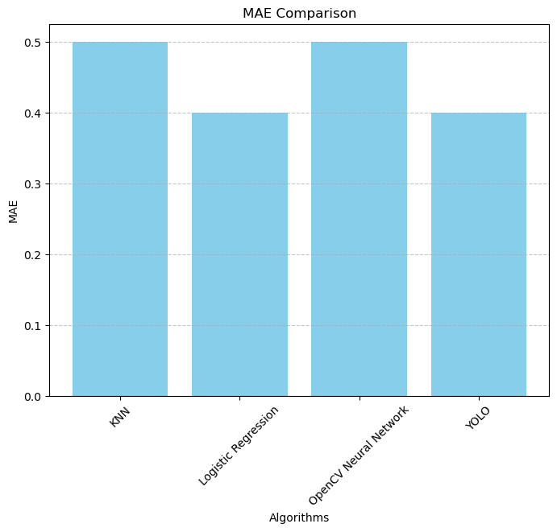
Final Results:
We have used results from these four algorithms to get a better understanding of how the models work.
We compared the results to know which model works better.
For comparison we used evaluation metrics such as RMSE, MAE, F1 score, accuracy, precision, and recall.

Slide 11
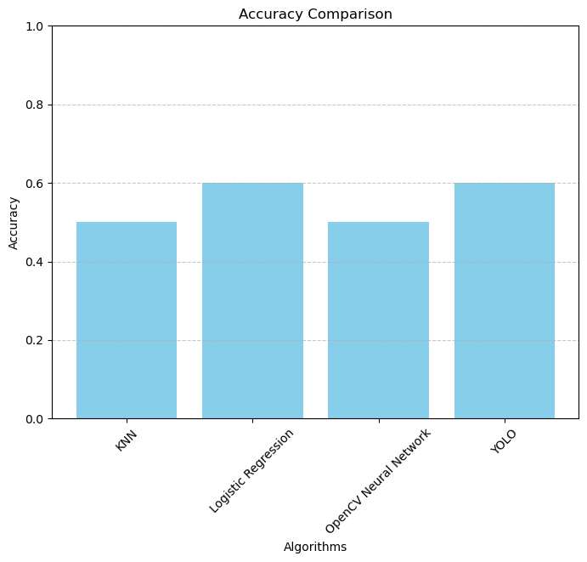
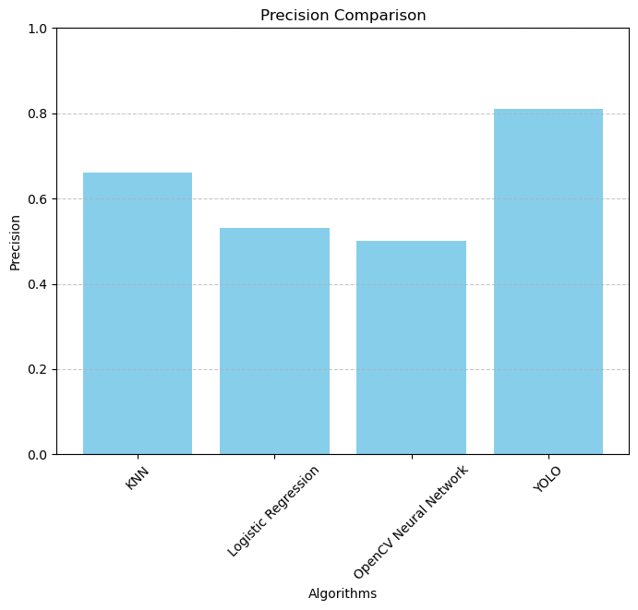

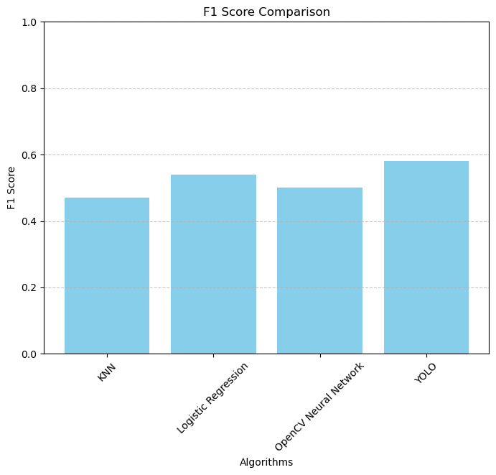
Final Results: (contd)

Slide 12
Conclusion:
The project effectively employs methods like YOLOv4, KNN, Logistic Regression, OpenCV with Neural Networks to detect facial expressions accurately.
By combining detection and classification techniques, the system achieves enhanced accuracy and efficiency,
YOLO performed the best among the four models because it had the highest precision (0.8133), meaning it made fewer false predictions.
It matched Logistic Regression in terms of accuracy but showed better F1 Score and classification balance. YOLO’s design for object detection contributed to its superior performance on the dataset.

